Slide 1


as a hypothetical bacterial immune system
DGR
Sokolov Arseny FS11-63B

Slide 2
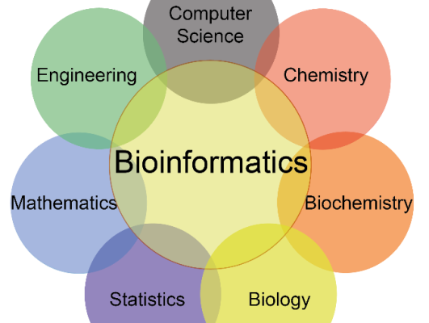
Bioinformatics

Slide 3
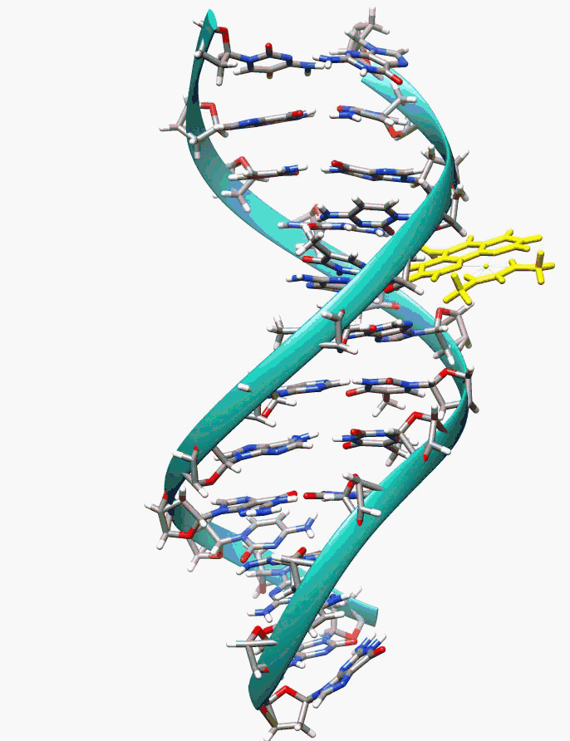
What is DNA?

Slide 4
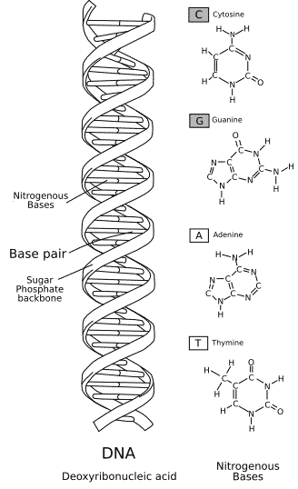
What is DNA?

Slide 5
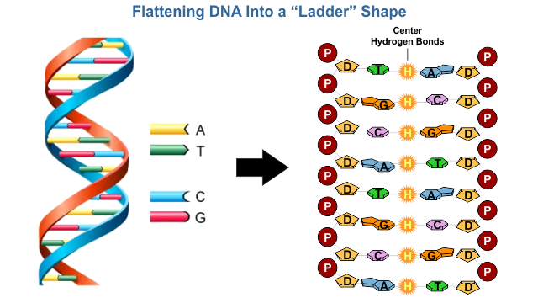
What is DNA?

Slide 6
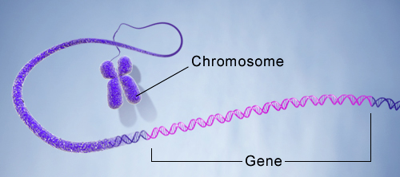
What is DNA?

